Slide 1

Meekness, Not Weakness
Matthew 5:5, Psalm 37:1-9

Slide 2
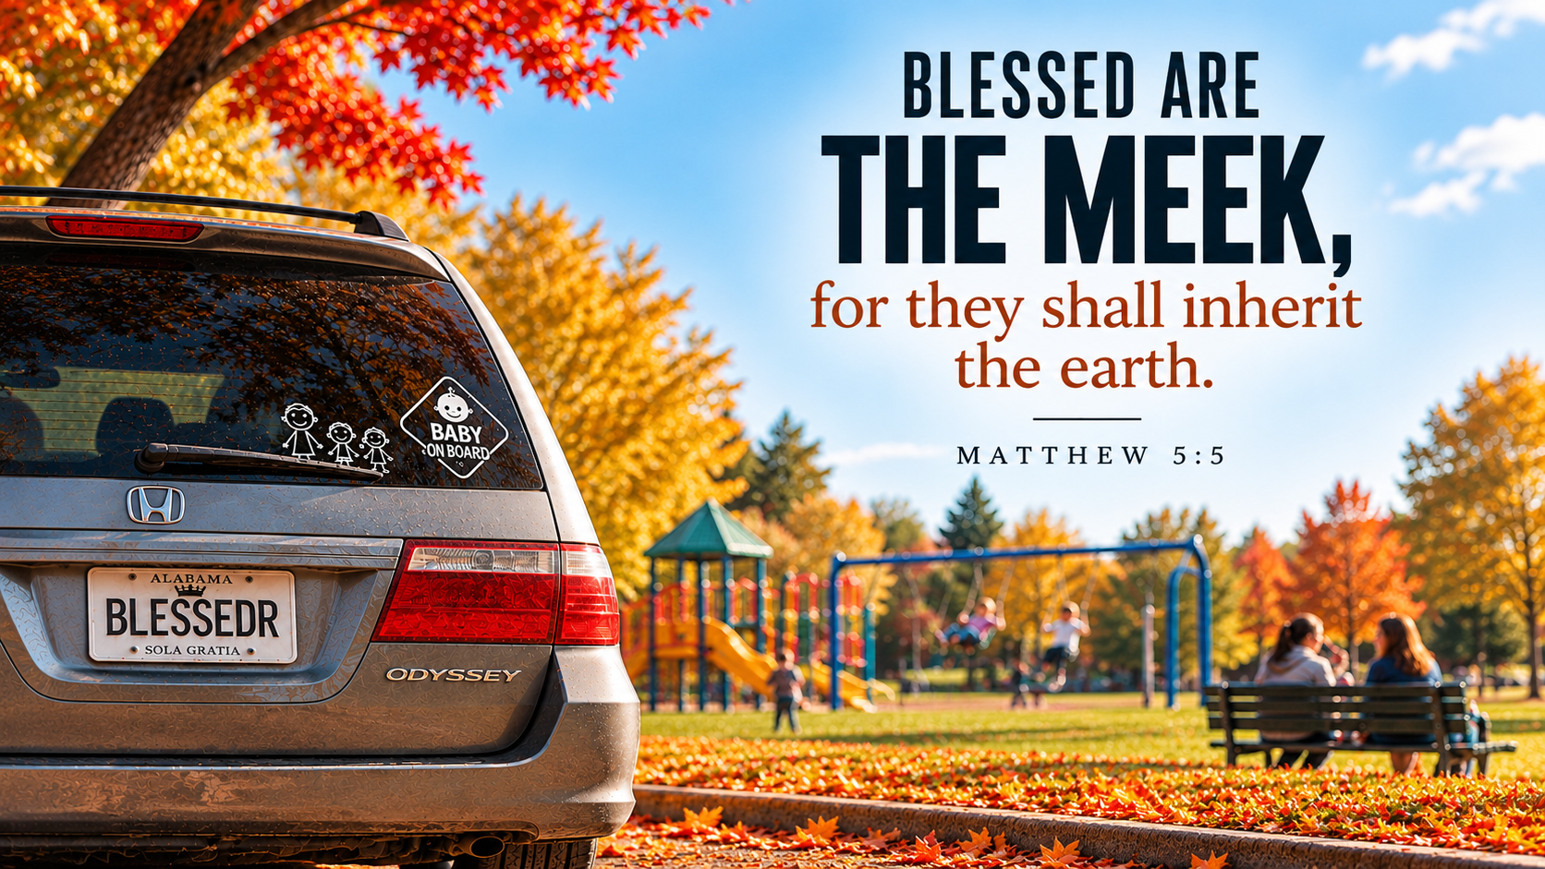

Slide 3
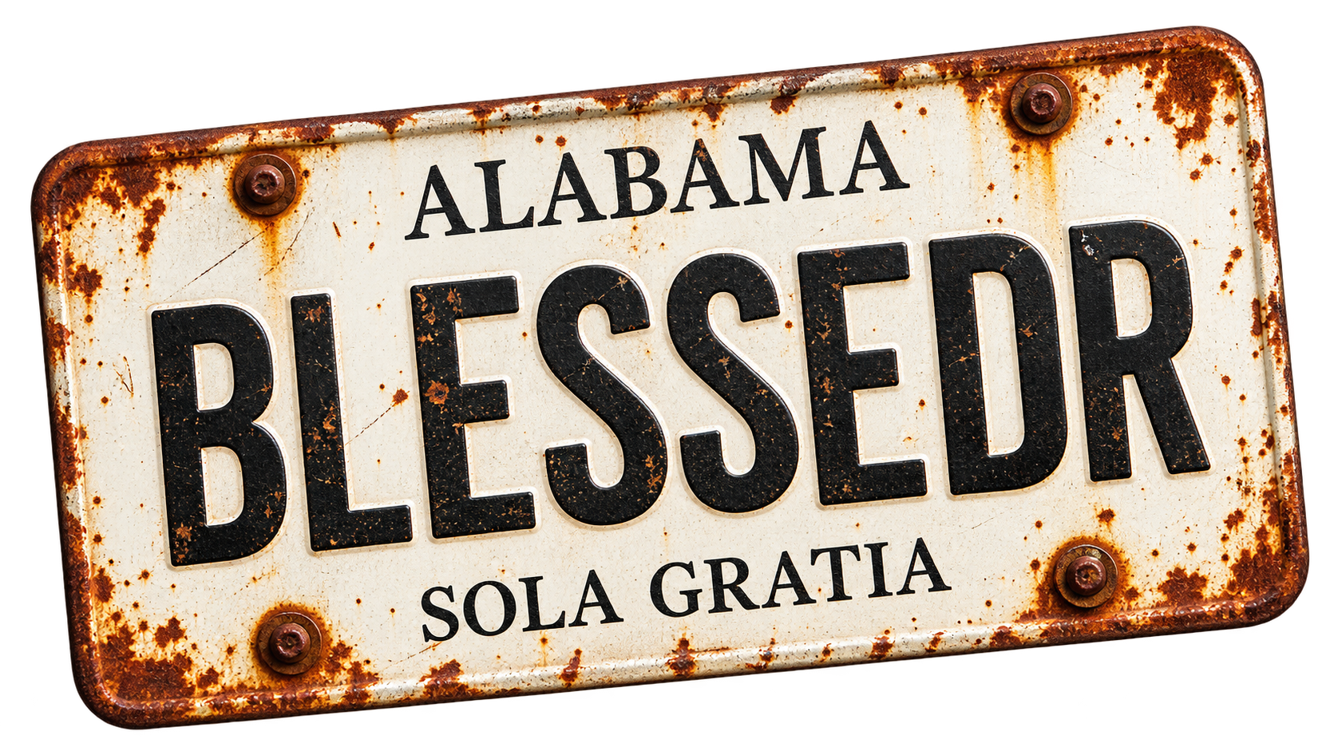
Poor In Spirit: Seeing YOURSELF Rightly

Slide 4
Poor In Spirit: Seeing YOURSELF Rightly
Mourn: Seeing YOUR SIN Rightly

Slide 5
Poor In Spirit: Seeing YOURSELF Rightly
Mourn: Seeing YOUR SIN Rightly
Meekness: Seeing GOD Rightly

Slide 6
³ “Blessed are the poor in spirit, for theirs is the kingdom of heaven.

Slide 7
⁴ “Blessed are those who mourn, for they shall be comforted.

Slide 8
⁵ “Blessed are the meek, for they shall inherit the earth.

Slide 9
⁶ “Blessed are those who hunger and thirst for righteousness, for they shall be satisfied.

Slide 10
⁷ “Blessed are the merciful, for they shall receive mercy.

Slide 11
⁸ “Blessed are the pure in heart, for the shall see God.

Slide 12
⁹ “Blessed are the peacemakers, for they shall be called sons of God.

Slide 13
¹⁰ “Blessed are those who are persecuted for righteousness’ sake, for theirs is the kingdom of heaven.

Slide 14
The Setting

Slide 15
The Setting
The Pharisees: A Mosaic Messiah

Slide 16
The Setting
The Pharisees: A Mosaic Messiah
The Sadducees: A Materialistic Messiah

Slide 17
The Setting
The Pharisees: A Mosaic Messiah
The Sadducees: A Materialistic Messiah
The Zealots: A Militant Messiah

Slide 18
The Setting
The Pharisees: A Mosaic Messiah
The Sadducees: A Materialistic Messiah
The Zealots: A Militant Messiah
The Essenes: A Separate Messiah

Slide 19
“Behold, your king is coming to you; righteous and having salvation is he, humble and mounted on a donkey, on a colt, the foal of a donkey.”
Zechariah 9:9

Slide 20
What Meekness Is– And Isn’t

Slide 21
What Meekness Is– And Isn’t
Take my yoke upon you, and learn from me, for I am gentle and lowly in heart, and you will find rest for your souls.
Matthew 11:29

Slide 22
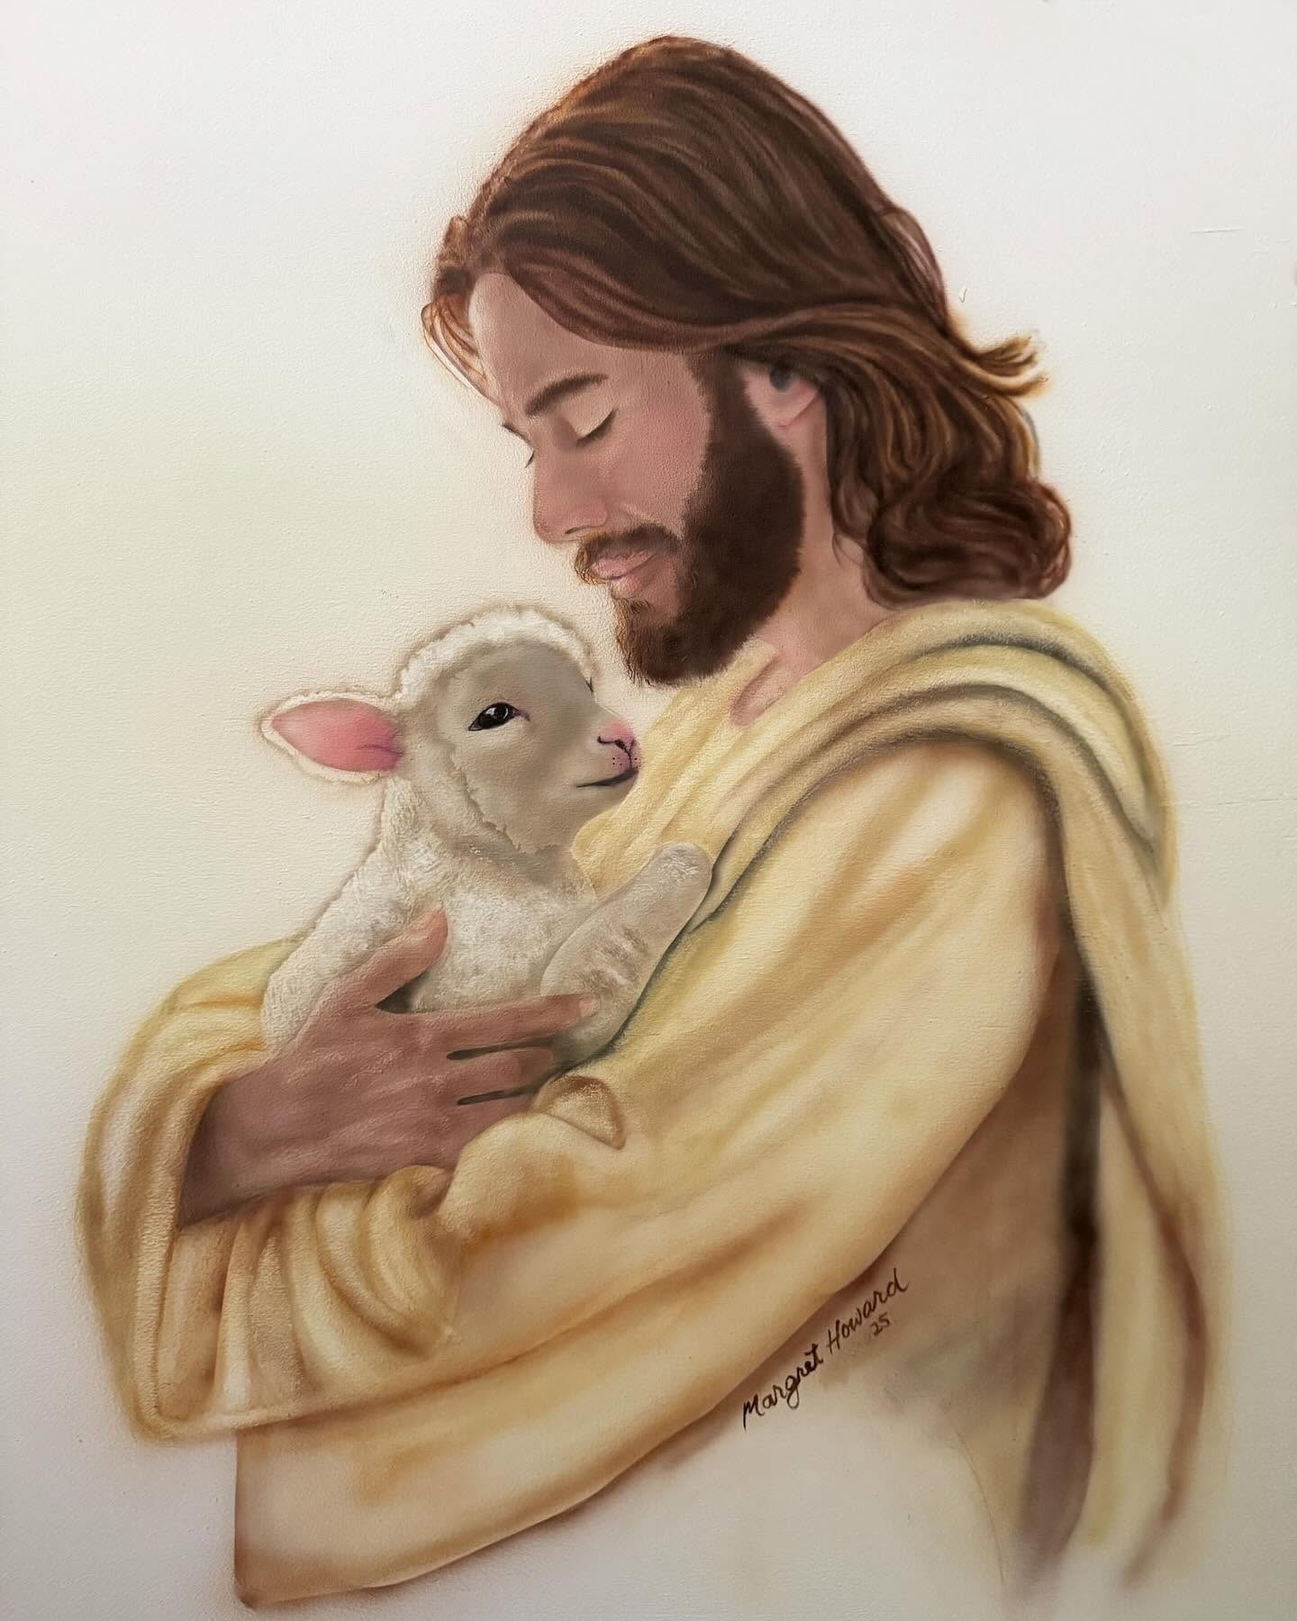

Slide 23
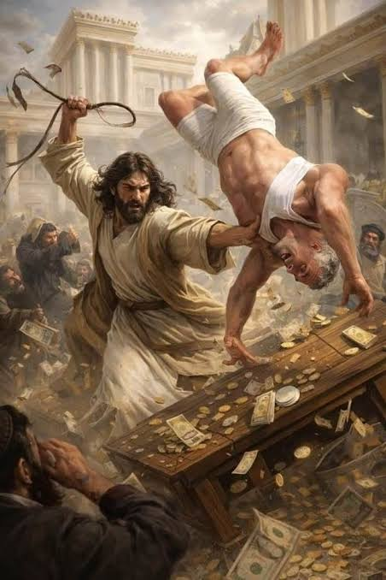

Slide 24
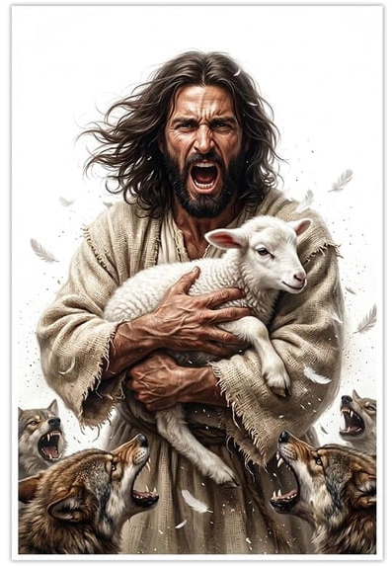

Slide 25
Meekness: Strength under control

Slide 26
Meekness is the result of being so secure in your position in Christ that you don’t have to worry about your position in the world.

Slide 27
“So let no one boast in men. For all things are yours, whether Paul or Apollos or Cephas or the world or life or death or the present or the future—all are yours, and you are Christ's, and Christ is God’s.”
1 Corinthians 3:21

Slide 28
“Look, these many years I have served you, and I never disobeyed your command, yet you never gave me a young goat, that I might celebrate with my friends But when this son of yours came, who has devoured your property with prostitutes, you killed the fattened calf for him!”
Luke 15:29

Slide 29
³¹ And he said to him, ‘Son, you are always with me, and all that is mine is yours. ³² It was fitting to celebrate and be glad, for this your brother was dead, and is alive; he was lost, and is found.’ ”
Luke 15:31-32

Slide 30
Examples From Scripture
Abraham (Genesis 13)

Slide 31
Examples From Scripture
Abraham (Genesis 13)
Joseph (Genesis 50)

Slide 32
Examples From Scripture
Abraham (Genesis 13)
Joseph (Genesis 50)
Jesus (Philippians 2)

Slide 33
“Have this mind among yourselves, which is yours in Christ Jesus, who, though he was in the form of God, did not count equality with God a thing to be grasped, but emptied himself, by taking the form of a servant, being born in the likeness of men.”
Philippians 2:5-7

Slide 34
⁸ And being found in human form, he humbled himself by becoming obedient to the point of death, even death on a cross.
Philippians 2:8

Slide 35
⁹ Therefore God has highly exalted him and bestowed on him the name that is above every name, ¹⁰ so that at the name of Jesus every knee should bow, in heaven and on earth and under the earth, ¹¹ and every tongue confess that Jesus Christ is Lord, to the glory of God the Father.
Philippians 2:9-11

Slide 36
How to be Meek (Psalm 37:1-11)
“But the meek shall inherit the land and delight themselves in abundant peace.”
Psalm 37:11

Slide 37
How to be Meek (Psalm 37:1-11)
Fret Not (v. 1, 7, 8)

Slide 38
How to be Meek (Psalm 37:1-11)
Fret Not (v. 1, 7, 8)
Trust In (v. 3, 5)

Slide 39
How to be Meek (Psalm 37:1-11)
Fret Not (v. 1, 7, 8)
Trust In (v. 3, 5)
Wait for (v. 7)

Slide 40
How to be Meek (Psalm 37:1-11)
Fret Not (v. 1, 7, 8)
Trust In (v. 3, 5)
Wait for (v. 7)
Commit to (v. 5)

Slide 41
Grief tells the truth about the way things are.
Grief makes us long for how things will be.
Grief us the gateway to God’s comfort.

Slide 42

1. Grief tells the truth

Slide 43

“Seeing the crowds, he went up on the mountain, and when he sat down, his disciples came to him. And he opened his mouth and taught them.”

Slide 44
BLESSED (Greek Makarios):
experiencing positive circumstances or a happy disposition.
A declaration of blessing

Slide 45
An Example: Luke 18:9-14

